Slide 1
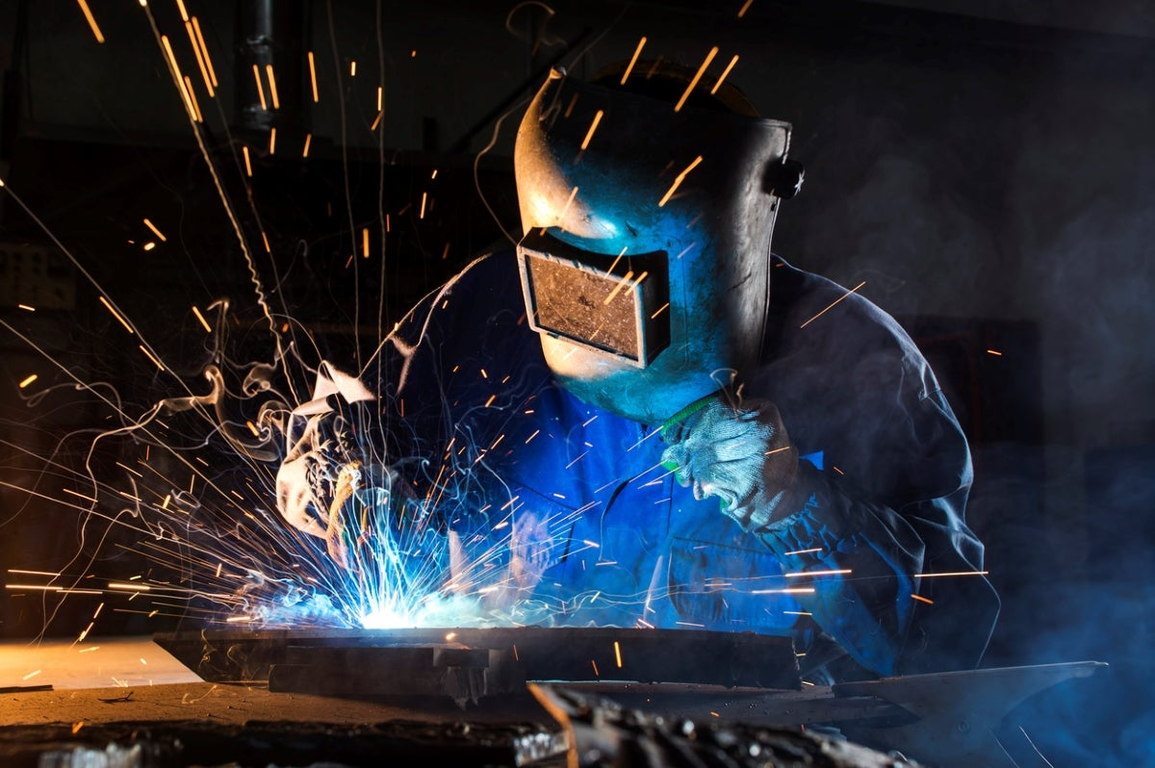
Soldering and Brazing
ME692A
Group Members
Sandesh Narayan
K Uday Kiran
Anurag Kumar

Slide 2
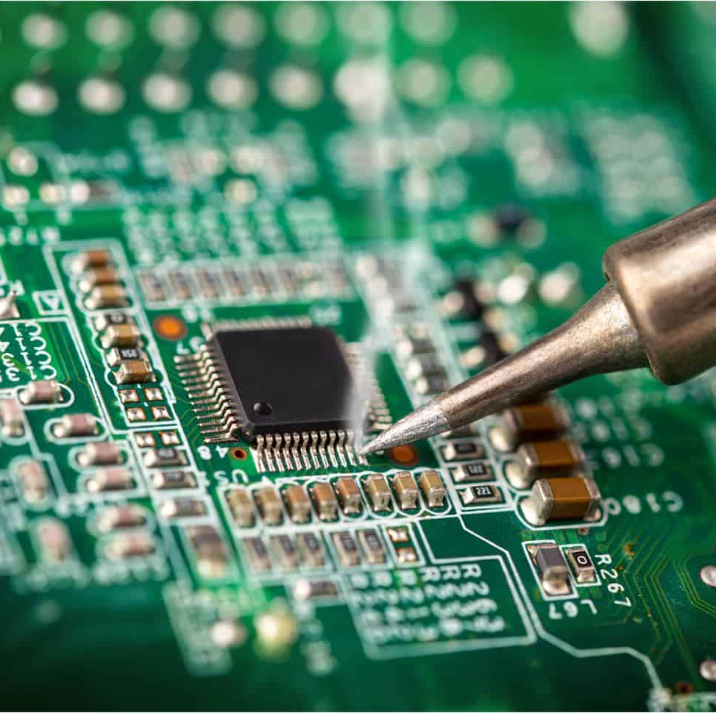
Introduction
Soldering and brazing are essential techniques in joining two metal parts.
Electronics, plumbing, and automotive, among others.
In both soldering and brazing, the metal parts to be joined are heated to a specific temperature to allow the filler material to flow into the joint and create a strong bond.

Slide 3
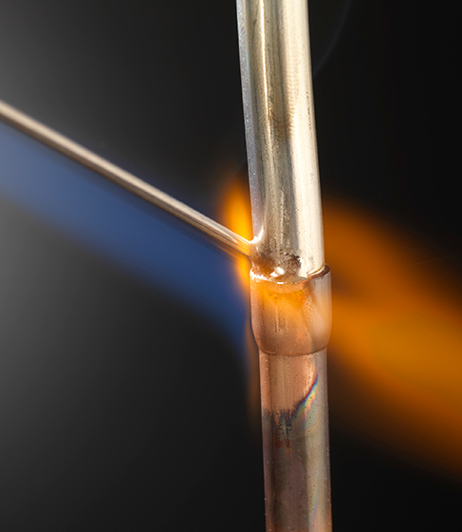
Brazing
Brazing is a process of joining two metal parts with the use of a high-temperature filler metal. The filler metal melts and flows into the joint to create a strong bond.
Automotive, aerospace, and HVAC industries.
Torch brazing – (most common) Torch brazing uses a flame to heat the metal parts and the filler metal to a high temperature to create a strong bond.
Induction brazing - This type of brazing uses high-frequency electromagnetic waves to heat the metal parts and the filler metal. Commonly used in the automotive and aerospace industries.
Furnace brazing - Uses a furnace to heat the metal parts and the filler metal to a high temperature. Used in HVAC industry.

Slide 4
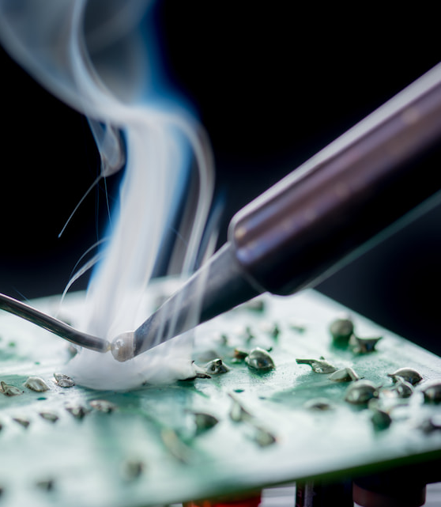
Soldering
Soldering is a process of joining two metal parts with the use of a low-temperature filler metal. The filler metal is melted and applied to the joint to create a strong bond.
Used in electronics, plumbing, and jewelry making .
Soft soldering - (most common) filler metal that melts at a temperature below 450°C. usually a combination of tin and lead or other metals such as silver or copper.
Hard soldering - filler metal with higher melting point Used in jewelry making and other applications that require a stronger bond.
Ultrasonic soldering - uses ultrasonic waves to melt the filler metal. Commonly used in electronics and microelectronics.

Slide 5
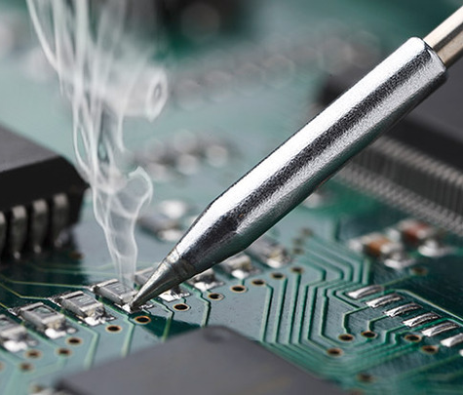
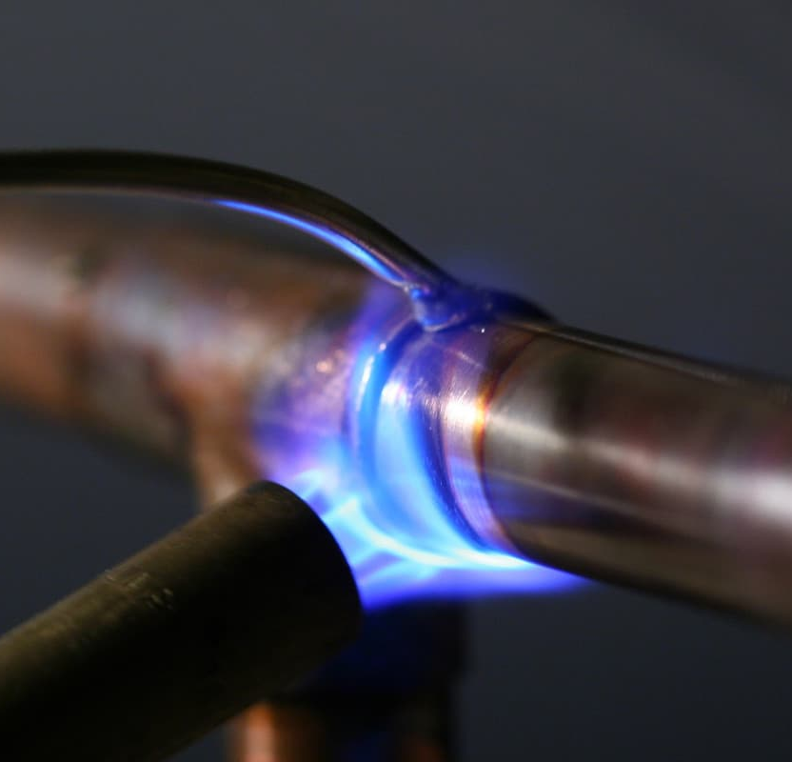
Differences between Soldering and Brazing
Soldering and brazing have significant differences in terms of temperature, filler metal, and strength. The following are the differences:
Strength - Brazing creates a stronger bond than soldering.
Soldering | Brazing
low-temperature filler metal | high-temperature filler metal
soft filler metal | hard filler metal
most common type of filler metal used in soldering is 60:40 tin lead alloy | where brass alloys

Slide 6
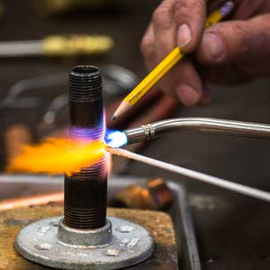
Applications
Soldering and brazing have various applications in different industries. The following are the applications:
Soldering - Electronics, plumbing, jewelry making, and musical instrument repair.
Brazing - Automotive, aerospace, HVAC, and metalworking.

Slide 7
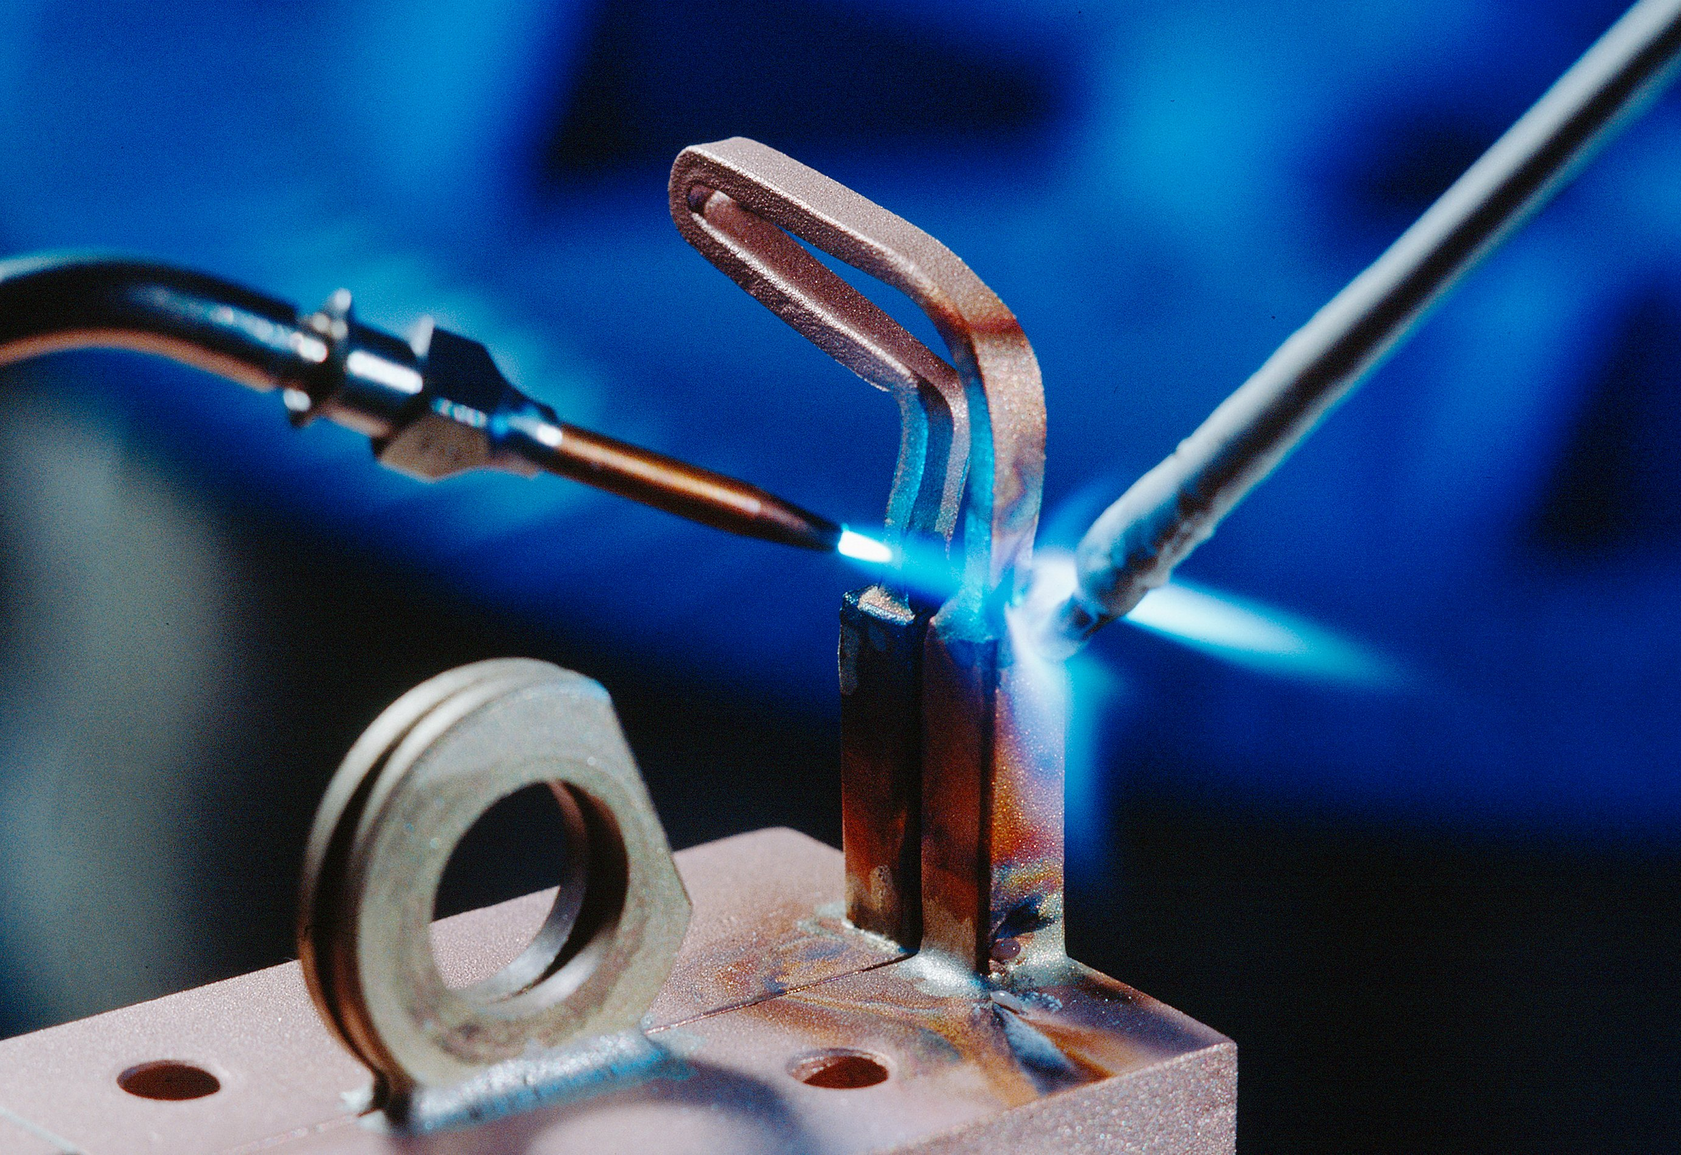
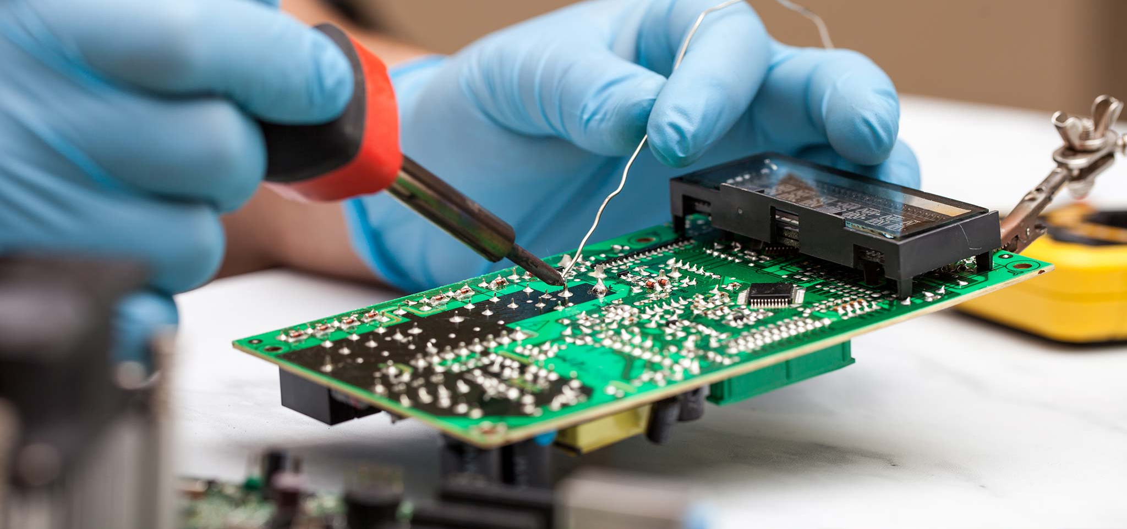
Conclusion
Both soldering and brazing are versatile techniques that are widely used in many industries and applications.
Soldering involves melting a lower melting point metal alloy called solder to create a bond, while brazing involves melting a higher melting point metal alloy called filler metal to create a bond.
Proper safety precautions should always be taken when using these techniques, as they involve working with high temperatures and potentially hazardous materials.

Slide 8
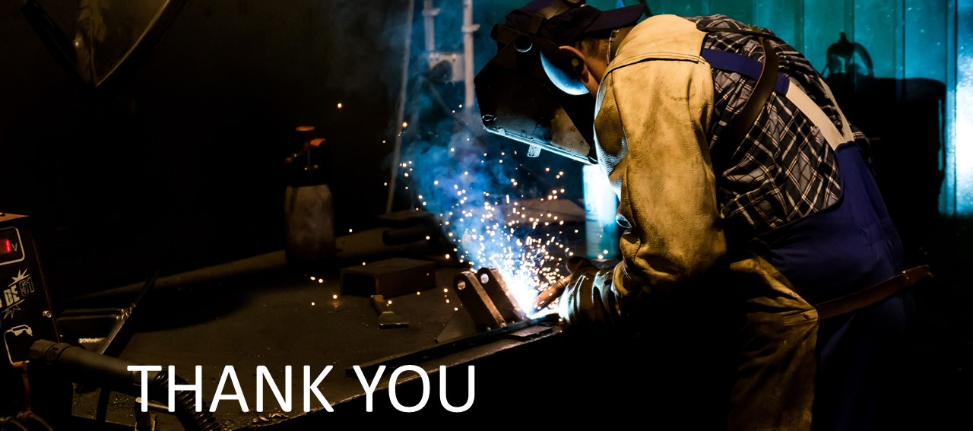
Professor Dr. Virkeshwar Kumar

